Slide 1

Fake News Detection

Slide 2
Introduction
"Fake News" is a term used to represent fabricated news or propaganda comprising misinformation communicated through traditional media channels like print, and television as well as non-traditional media channels like social media. The general motive to spread such news is to mislead the readers, damage reputation of any entity, or to gain from sensationalism.
Fake news is increasingly being shared via social media platforms like Twitter and Facebook. These platforms offer a setting for the general population to share their opinions and views in a raw and un-edited fashion.

Slide 3
Problem
In most cases, the people creating this false information have an agenda, that can be political, economic or to change the behavior or thought about a topic.
There are countless sources of fake news nowadays, mostly coming from programmed bots, that can’t get tired (they’re machines) and continue to spread false information 24/7.

Slide 4
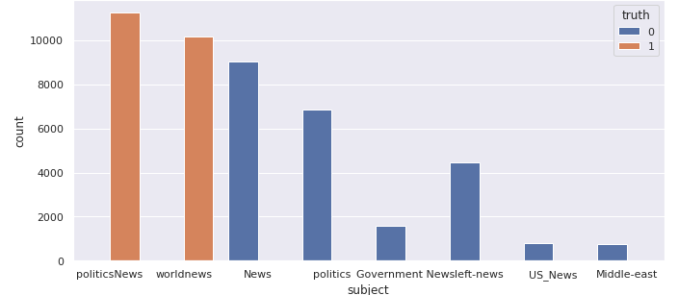
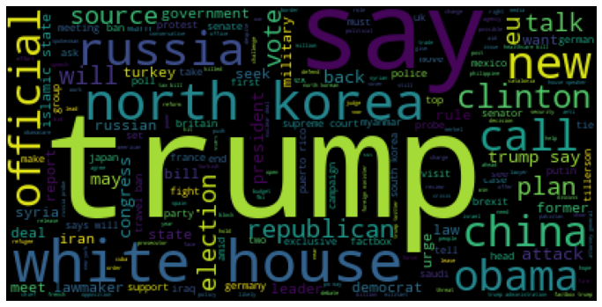
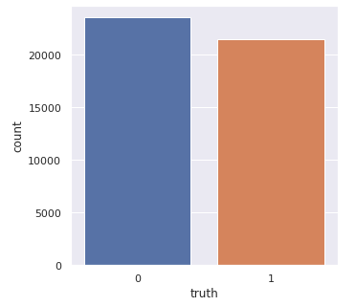
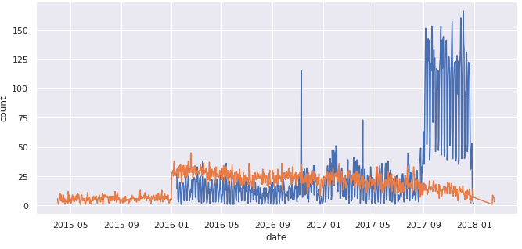
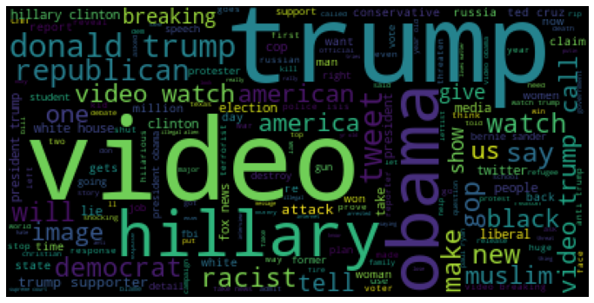
Data Collection and Exploration
The data set has been downloaded from the Kaggle & Signal Media News datasets.

Slide 5
Workflow process
Fake News Dataset
Real News Dataset
Text Cleaning
Tokenize + Padding
Word Embedding
Modeling
Evaluation

Slide 6
Data Preparation
Cleaning the data set by avoiding special characters and avoiding the stop words.
In most of the NLP tasks, we need to represent each word in the text with an integer value (index) before feeding it to any model. Hence, we need to convert them into 1’s and 0’s.
All input sequences to the model need to have the same length. Hence, Padding has been done.
Word Embedding. It is a way to represent words with similar meaning to have a similar representation.

Slide 7
Neural Networks Explored
Natural language processing refers to the way we, humans communicate with each other.
Recurrent neural networks, or RNNs, have been designed to work on sequence prediction problems.
LSTMs & GRU have received the most success when working with sequences of words and paragraph.
CNNs are generally used in computer vision, however they’ve recently been applied to various NLP tasks.

Slide 8
Modeling
The first layer in all the models is the Embedding layer.
For RNN model, After the Embedding layer, we have a layer of LSTM or GRU.
For CNN model, after Embedding layer, we have a convolution layer followed by max pooling layer.
A Dropout layer for regularization has been added.
Then a Dense layer with Sigmoid activation which transforms the output of previous layers to 0 or 1 (real or fake).

Slide 9
Hyperparameters
Models | Embedding Size | Optimizer | Dropout | Epochs
LSTM | 100 | Adam | 0.3 | 10
GRU | 100 | Adam | 0.3 | 10
Max pooling | 100 | Adam | 0.3 | 10
Global Average pooling | 100 | Adam | 0.3 | 10

Slide 10




Model Performance
Models | Training Accuracy | Test Accuracy | Confusion Matrix
LSTM | 96.93 | 95.94
GRU | 99.72 | 98.55
Max pooling | 99.59 | 97.10
Global Average pooling | 87.13 | 87.77

Slide 11
Future Directions
For Fake news detection, we can add more features beyond the vectors corresponding to the words in title or text such as source of news, any associated URLs, the topics, publishing medium, country or region of origin etc.
I plan to continue this effort after the class ends.

Slide 12
Thank You

